Slide 1


Travel free. Travel in style.

Slide 2
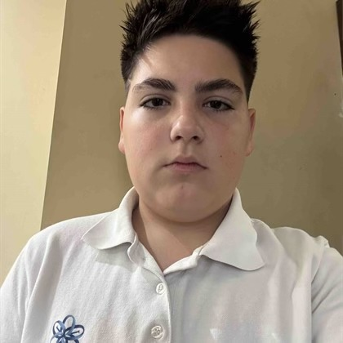
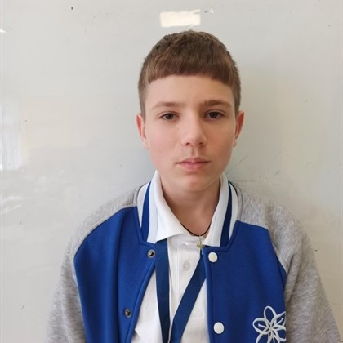
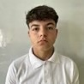
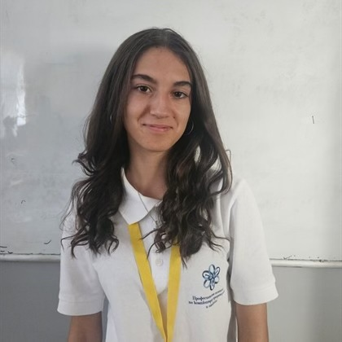
Our team
Our team
Stoyan Tanev
8B
Scrum Trainer
Vilian Ivanov
8G
CSS Developer
Krisitiyan Georgiev
8V
Designer
Dara Sokrateva
8A
CSS Developer

Slide 3

Our Idea
Our goal is to create a user-friendly website that makes renting a car simple, convenient, and stress-free—whether you're planning a holiday adventure, a weekend getaway, or just need a vehicle for your everyday needs.

Slide 4

STAGES OF DEVELOPMENT
WEEK 1
WEEK 2
WEEK 3
WEEK 4
Creating logo and discussing ideas about the site
Making the design
and implementing our ideas through code
Developing the code
Creating the documentation and presentation

Slide 5







Used Technologies

Slide 6

LET’S MOVE TO THE DEMONSTRATION!

